Slide 1
Skechers Design Center and Executive Offices Project
Environmental Impact Report
Planning Commission Hearing
July 18, 2017

Slide 2
CEQA Purposes
Disclose the significant environmental effects of proposed actions
Identify ways to avoid or reduce environmental damage
Consider feasible alternatives to proposed actions
Facilitate public participation

Slide 3
CEQA Environmental Review Process
City circulates Notice of Preparation (30 days)
City prepares Draft EIR
City files Notice of Completion
We are here
Public Review Period (60 days)
City prepares Final EIR
City prepares Findings
City makes a decision on the project

Slide 4
Hermosa Beach Site
2851, 2901, 3001, & 3125 Pacific Coast Highway
Currently developed with new and used auto sales & repair facilities
All buildings currently vacant

Slide 5
Manhattan Beach Sites
305, 309, 317 S. Sepulveda Boulevard; 1050 Duncan Avenue (west side of Sepulveda)
Currently developed with small commercial buildings; other buildings recently demolished
330 S. Sepulveda Boulevard (east side of Sepulveda)
Currently vacant; former car wash demolished

Slide 6
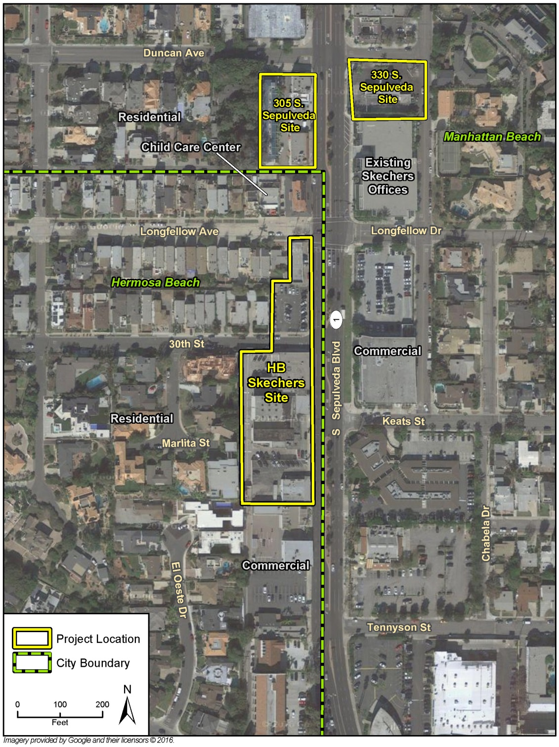
Development Sites and Surrounding Land Uses

Slide 7
Hermosa Beach Component
Project Component | Details
Design Center | 100,296 square feet of building area South of 30th Street 35-40 showrooms , 35- 40 product development rooms, offices, cafeteria, and ancillary uses, outdoor terraces 520 subterranean parking spaces Up to 430 employees Host large company meetings approximately 2 times a year
Executive Offices | 20,207 square feet of building area North of 30th street Offices, patio, lobby, dining area, coffee house 89 subterranean parking spaces 80 employees
Building Height | 35 feet above grade (3 stories)

Slide 8
Project Objectives
Develop a new Design Center to display Skechers shoes in modern state of the art showrooms in one location
Create facilities providing sufficient space for additional offices to meet current and future needs, as well as showrooms that would be used during conference events hosted by Skechers approximately twice per year
Maintain proximity to the existing Skechers campus and Los Angeles International Airport
Generate 655 new jobs in the cities of Hermosa Beach and Manhattan Beach.
Achieve LEED Gold Certification for all three project components
Create a consistent pattern of development along SR 1 that matches the existing Skechers campus and redevelops three underutilized sites

Slide 9
Hermosa Beach Requested Approvals
Certification of the Final EIR
Lot Line Adjustments to combine four parcels into one lot on each side of 30th Street
Precise Development Plan
Administrative Use Permit for the outdoor patio
Parking Plan to account for buses and conferences, at the Design Center only
Vacation of the alley west of/behind 2851 SR 1
Subsurface vacation of 30th Street or other entitlement to allow underground pedestrian tunnel between the two buildings
Construction and encroachment permits

Slide 10
305 S. Sepulveda Component
Project Component | Details
Office Building | 37,174 square feet of building area Outdoor terrace on the 2nd floor facing Sepulveda Blvd. 150 employees
Parking | 3 subterranean levels 199 spaces (124 required per code)
Building Height | 30 feet above grade (2 stories)

Slide 11
330 S. Sepulveda Component
Project Component | Details
Office Building | Expansion of the existing Skechers building 20,328 square feet of new building area (75,373 total) Deck facing Sepulveda on 1st and 2rd floors for employee use Walkways on the 1st and 2rd floors connect to the existing building 75 employees
Subterranean Parking | 4 subterranean levels 119 spaces (389 total)
Building Height | 30 feet above grade (2 stories)

Slide 12
Manhattan Beach Requested Approvals
305 S. Sepulveda
Use Permit for development on Sepulveda Boulevard
Lot Line Adjustment to combine 3 lots into 1
330 S. Sepulveda
Use Permit Amendment for alteration of the existing building’s Use Permit
Lot Merger to combine 2 lots into 1

Slide 13
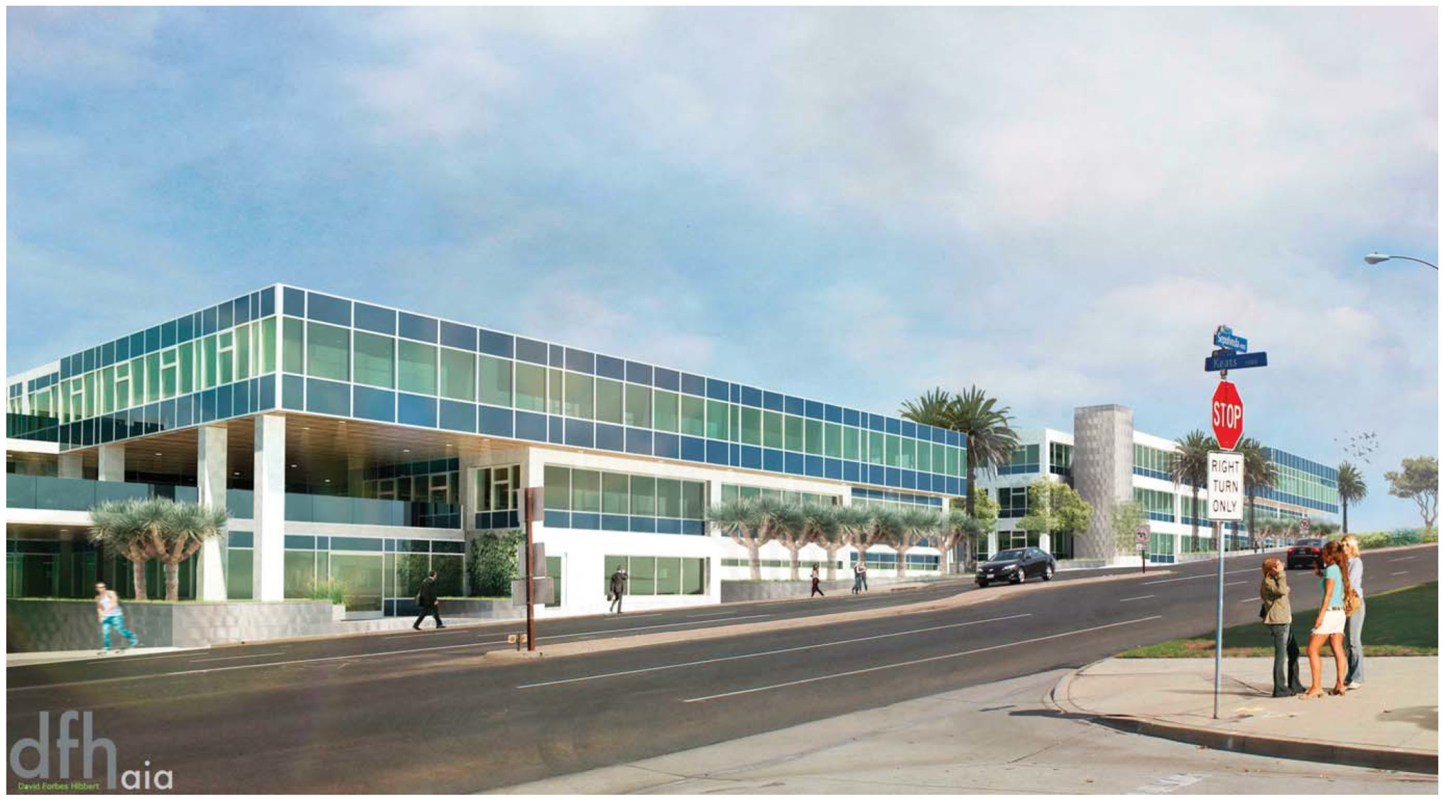
Photosimulation of Design Center
Hermosa Beach Site

Slide 14
Issues Analyzed in the EIR
Aesthetics
Air Quality
Biological Resources
Cultural Resources
Geology
Greenhouse Gases
Hazards and Hazardous Materials
Land Use and Planning
Population & Housing
Noise
Transportation/Traffic
Utilities and Service Systems
Red text indicates a significant and unavoidable impact.

Slide 15
Analysis Approach
Site-specific review of each project component
Focus on impacts to neighboring properties
Consideration of both temporary construction effects and long-term operational effects
Evaluation of overall effects of the three combined components
Evaluation of the three components in combination with other planned and pending (cumulative) development

Slide 16
Temporary Construction Noise
Noise exceeding ambient levels throughout construction at all three sites
Construction activity limited to allowable hours (8-6 in Hermosa Beach, 7:30-6 in Manhattan Beach)
Impact at Hermosa Beach site significant because of:
Exceedance of current 45 dBA Lmax standard
Long duration of construction (30 months)

Slide 17
Construction Noise Mitigation
On-site staging area to minimize off-site transportation of heavy construction equipment
Use the newest available power construction equipment with standard recommended noise shielding and muffling devices
Use of electrically-powered tools
Use of temporary solid noise attenuation barrier that achieves the maximum sound attenuation feasible
Operation of equipment with closed engine doors and mufflers consistent with manufacturers’ standards
Non-automated telephone number for local residents and employees to call to submit complaints associated with construction noise
Scheduling of construction activities to avoid operating several pieces of equipment simultaneously

Slide 18
Temporary Construction Traffic
Significant impacts at
SR 1/30th Street
SR 1/Keats Street
SR 1/Tennyson Street
Greatest impacts during excavation (24 months)
Truck staging in front of construction sites limited to off-peak traffic hours
Further mitigation beyond standard construction management not available

Slide 19
Operational Traffic Impacts (x denotes a significant impact)
Intersection | Combined Project (all three components) |  |  | Hermosa Beach Only |  |  | 305 S. Sepulveda Only |  |  | 330 S. Sepulveda Only
 | Hermosa Beach Criteria | Manhattan Beach Criteria | Caltrans Criteria | Hermosa Beach Criteria | Manhattan Beach Criteria | Caltrans Criteria | Hermosa Beach Criteria | Manhattan Beach Criteria | Caltrans Criteria | Hermosa Beach Criteria | Manhattan Beach Criteria | Caltrans Criteria
9. SR 1 / Manhattan Beach Blvd. |  |  | X |  |  | X
12. SR 1 / Duncan Ave.-Duncan Dr. |  | X | X |  | X | X |  | X | X
13. SR 1 / Longfellow Ave. – Longfellow Dr. | X
14. SR 1 / 30th St. | X | X | X | X | X | X |  |  |  |  | X | X
15. SR 1 / Keats St. | X | X | X | X | X | X |  | X | X
16. SR 1 / Tennyson St. |  | X | X |  | X | X |  | X | X |  | X | X
17. SR 1 / Gould Ave. – Artesia Blvd. | X | X | X |  | X | X |  |  | X
Total Number of Significant Intersection Impacts | 4 | 5 | 6 | 2 | 5 | 6 | 0 | 3 | 4 | 0 | 2 | 2

Slide 20
Traffic Mitigation
Combination of physical improvements and transportation demand management (TDM)
If all measures implemented, impacts reduced to less than significant
Traffic signals needed at
SR 1/Duncan Avenue
SR 1/30th Street
SR 1/Keats Street
Caltrans approval needed, but unlikely for all three signals

Slide 21
Alternatives
No Project
Commercial Retail
Consistent with C-3 & CG zones
185,566 sf of retail development (all three sites)
Reduced Project Size
Option A: Reduce all components by 14%
Option B: Remove coffee shop/reduce Design Center size

Slide 22
Alternatives (cont’d)
Commercial Retail
Substantially greater daily and PM peak hour traffic
Potential for significant air quality & GHG impacts
Would not meet project objectives related to developing a Design Center, providing sufficient space, or creating new jobs
Reduced Project Size
Avoids significant traffic impact at one intersection (SR 1/Longfellow)
Other potentially significant traffic impacts remain
Incremental reduction in other impacts
May not meet objectives related to meeting future space needs and creating jobs

Slide 23
Alternatives Considered, but Rejected
Signalization of SR 1/Keats Intersection
Restriction of Access to SR 1
Ground Level Parking between Skechers and Residences
Larger Setback between Hermosa Beach Component and Residences
No 30th Street Access to Hermosa Beach Parking Structure
Pedestrian Bridge Across SR 1
Phasing Construction
Further Reduced Project
Alternative Site

Slide 24
EIR Schedule
8/15/2017 – End of Draft EIR comment period
August-October 2017 – City/consultant team prepares Final EIR
Responses to comments on Draft EIR
Mitigation Monitoring Plan
November 2017 – January 2018 - Hearings on Final EIR and project

Slide 25
Questions?

